Slide 1
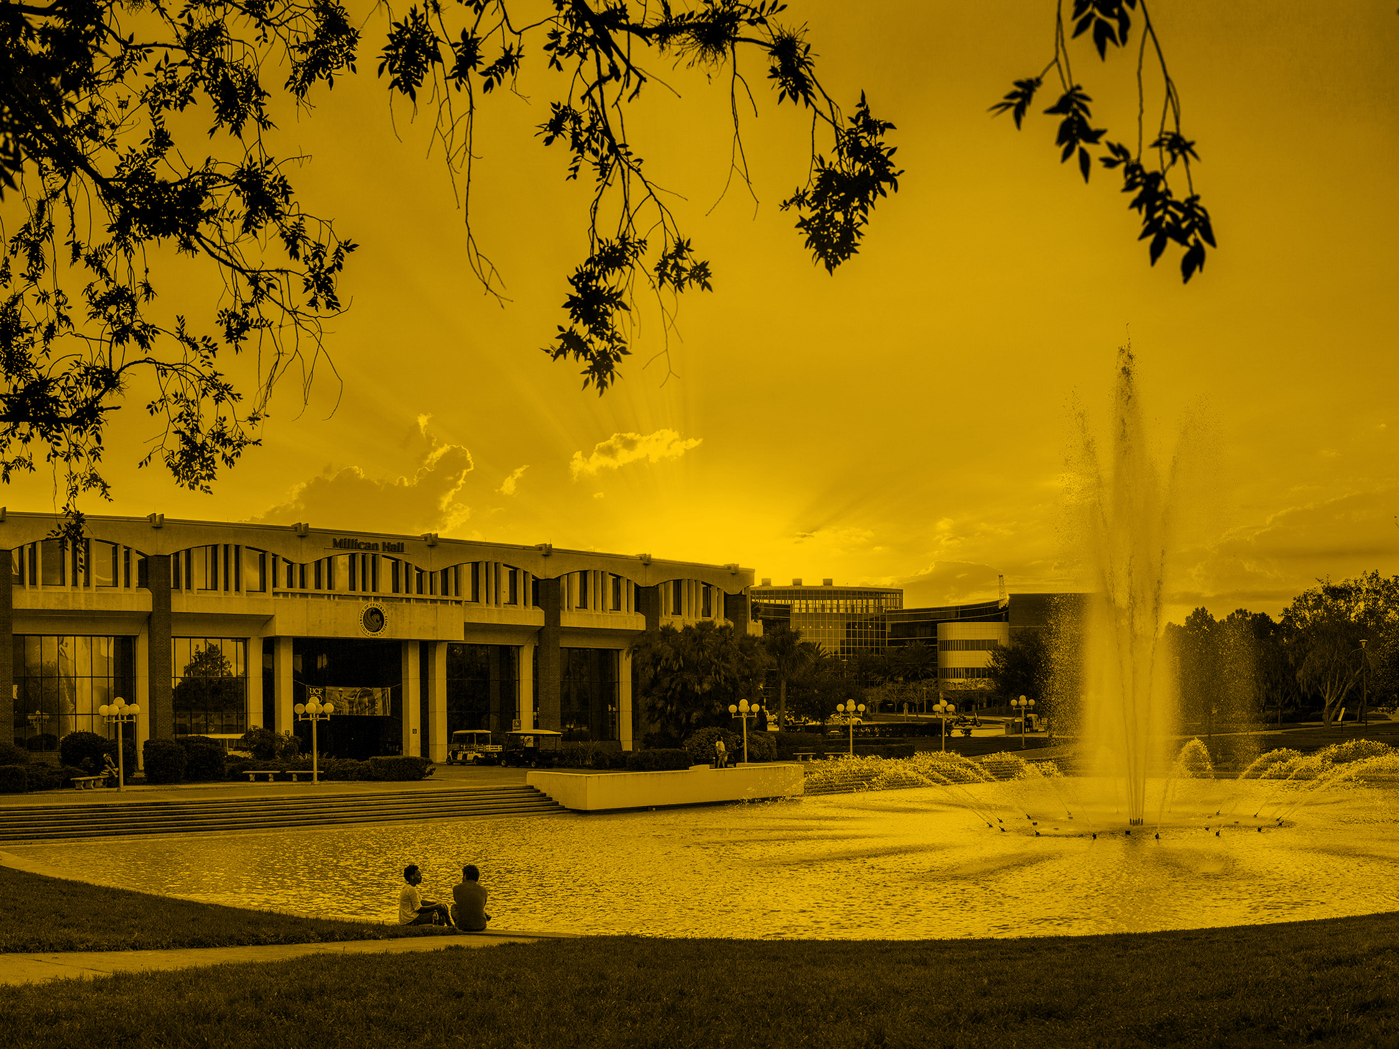

Creating artificial human genomes using generative neural networks Chakib Cerny

Slide 2
Overview
Why is creating an artificial human important ?
Limitations and challenges
Existing work
What is a Generative adversarial network (GAN) ?
What is a Restricted Boltzmann machine (RBM) ?
Genome Wide Reconstruction

Slide 3
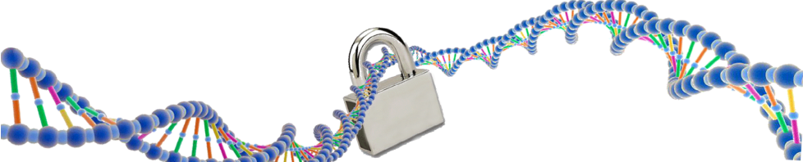
Why is creating an artificial human genome important ?
Privacy
Underrepresented population
Increase existing data available

Slide 4
Privacy
Why is creating an artificial human genome important ?
Federal regulation
Individual medical confidentiality

Slide 5
Underrepresented population
Why is creating an artificial human genome important ?
Representation of the global population
Study on specific community

Slide 6
Increase existing data available
Why is creating an artificial human genome important ?
Bigger data sets for the academia
More diverse data sets
Larger freedom for data pre-processing
Implementation of newest technics

Slide 7
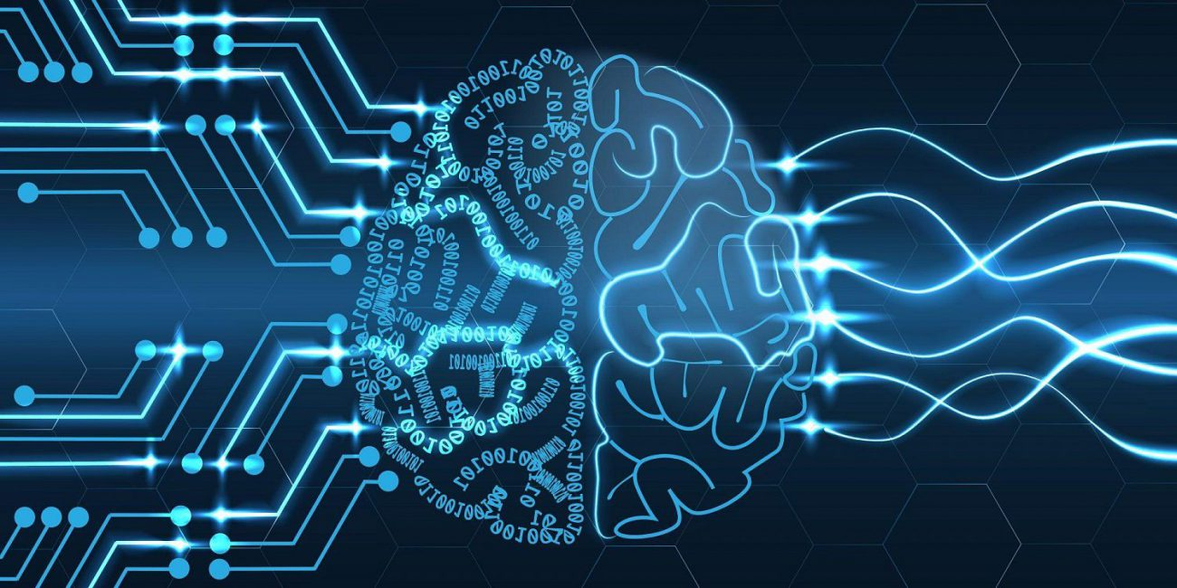
Limitations and challenges
Genome complexity
Computational limitations

Slide 8
Limitations and challenges
Genome complexity
- Whole genome generation
Discover intrinsic properties of data

Slide 9
Limitations and challenges
Computational limitations
Training Data set
Neural network accuracy (Generative – Discriminative)
Genome data size

Slide 10
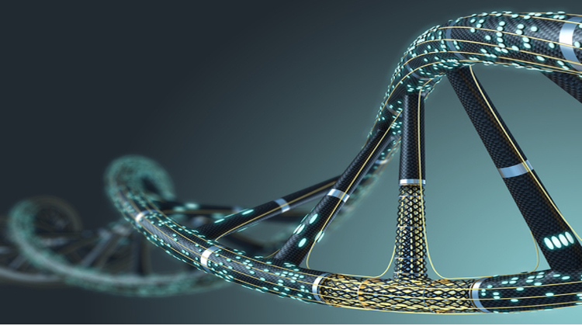
Existing work
HAPGEN2
Coalescent simulations

Slide 11
Existing work
HAPGEN2
Not a whole genome generator
Overfitting
Privacy loss
Multiple direct genomes copies
https://mathgen.stats.ox.ac.uk/genetics_software/hapgen/hapgen2.html#:~:text=HAPGEN2%20is%20a%20an%20updated,are%20in%20Hardy%2DWeinberg%20equilibrium.
Notes:
https://mathgen.stats.ox.ac.uk/genetics_software/hapgen/hapgen2.html#:~:text=HAPGEN2%20is%20a%20an%20updated,are%20in%20Hardy%2DWeinberg%20equilibrium.

Slide 12
Existing work
Coalescent simulations
Requires additional parameters
Can’t be combined with real genome
Difficulty of evaluation
Optimized for only specific populations

Slide 13
Existing work
How is GAN different than SLiM ?
SLiM is model based simulation that given specific parameters will simulate the evolution of ancestral population
- forward simulator (follows evolution of ancestral population)
- Need for parameters
- Demographic
- Evolutionary
https://messerlab.org/slim/
Notes:
We want to highlight that AGs are created without requiring the knowledge of the underlying evolutionary history, or the pre-processing bioinformatic pipelines

Slide 14
What is a Generative adversarial network (GAN) ?
Quick history
Neural Networks
Generator
Discriminator
Design Overview

Slide 15
What is a Generative adversarial network (GAN) ?
Quick history
Designed by Ian Goodfellow and his colleagues in 2014
Started as two networks competing against each other
2017, exponential grow in computer vision
2020, Nvidia recreated PacMan with just a GAN.
https://gitlab.com/chakib.cerny/ag/-/blob/master/genome.py

Slide 16
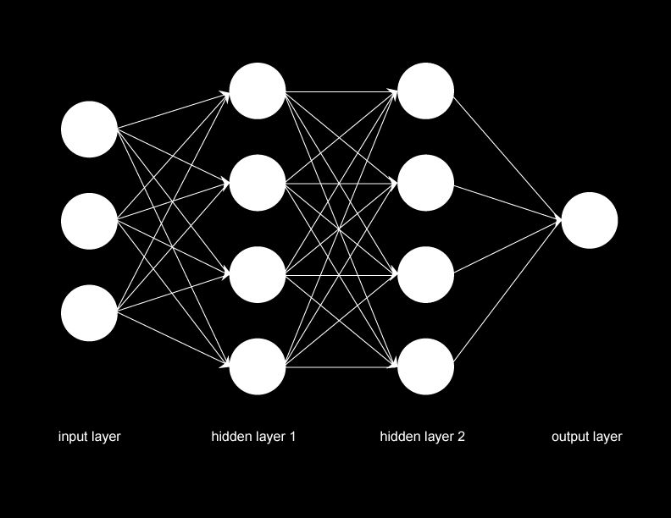
What is a Generative adversarial network (GAN) ?
Neural Networks

Slide 17
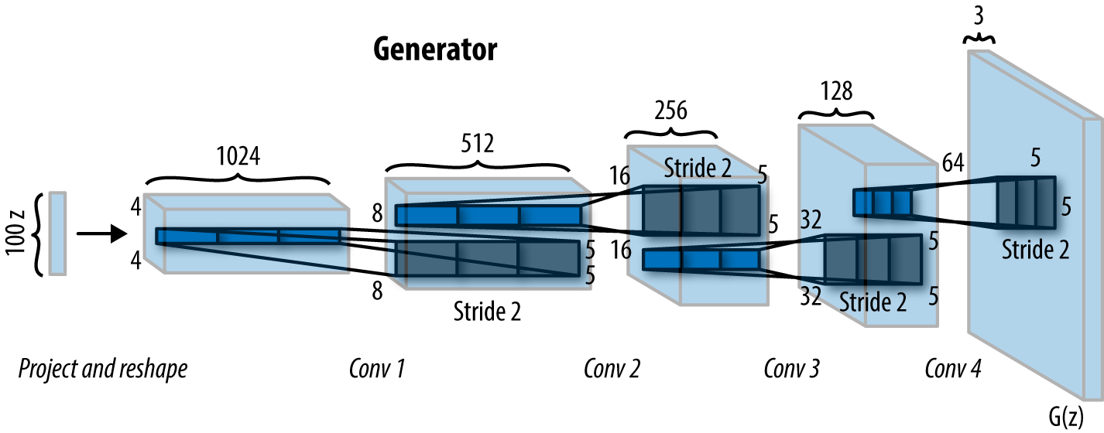
What is a Generative adversarial network (GAN) ?
Generator

Slide 18
What is a Generative adversarial network (GAN) ?
Generator
2 hidden layers (670 & 732)
2 leaky ReLU
1 activation function (tanh)

Slide 19
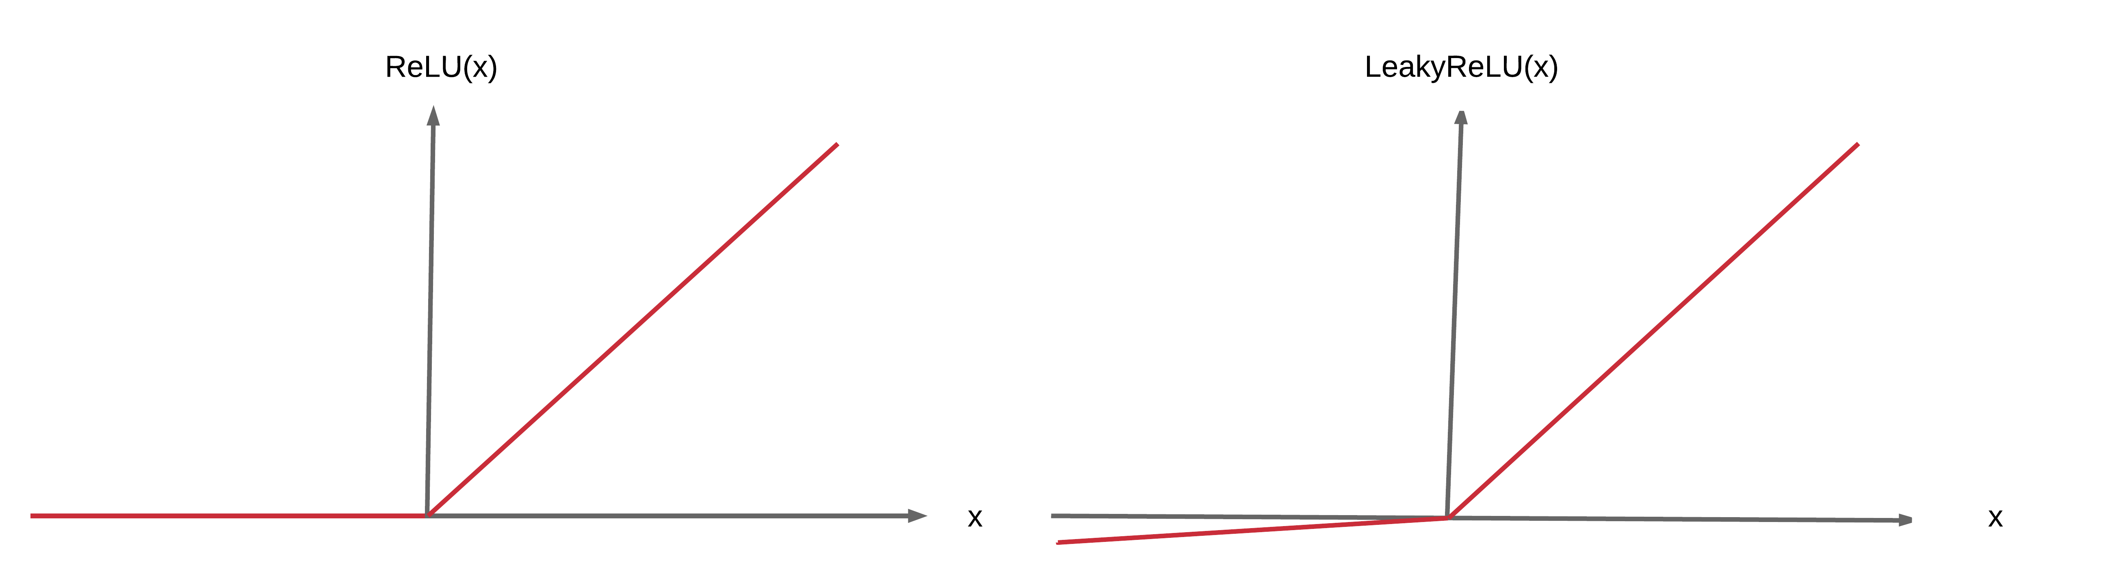
What is a Generative adversarial network (GAN) ?
Generator
RELU It has become the default activation function for many types of neural networks because a model that uses it is easier to train and often achieves better performance.
Notes:
rectified linear activation function or ReLU for short is a piecewise linear function that will output the input directly if it is positive, otherwise, it will output zero

Slide 20
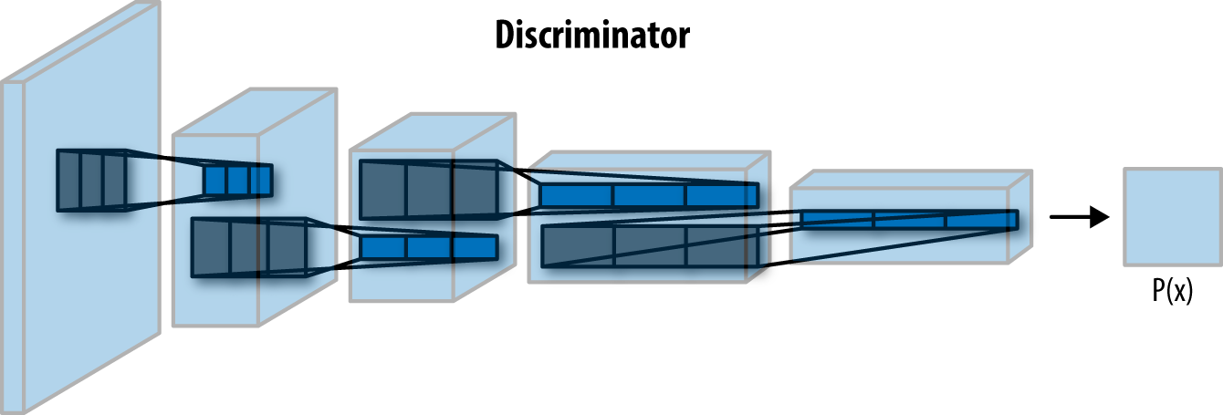
What is a Generative adversarial network (GAN) ?
Discriminator

Slide 21
What is a Generative adversarial network (GAN) ?
Discriminator
2 hidden layers (402 & 269)
2 leaky ReLU
1 activation function (sigmoid)

Slide 22
What is a Generative adversarial network (GAN) ?
Design Overview
Notes:
10001 Epochs !!!!

Slide 23
What is a Restricted Boltzmann Machine (RBM) ?
Quick history
RBM Structure
Training process (input reconstruction)
Pattern recognition
https://gitlab.com/chakib.cerny/ag/-/blob/master/GeneRBM.jl

Slide 24
What is a Restricted Boltzmann Machine (RBM) ?
Quick history
Initially invented by Paul Smolensky in 1986
Redesigned to its actual algorithm by Geoffrey Hinton in the mid-2000
Constant grows in deep beliefs networks
Ability to work in supervised and unsupervised learning

Slide 25
What is a Restricted Boltzmann Machine (RBM) ?
RBM Structure
Visible layer - Hidden layer
Written in Julia

Slide 26
What is a Restricted Boltzmann Machine (RBM) ?
Training process
Weight
Bias
Backward

Slide 27
Genome Wide Reconstruction
Dataset
RBM & GAN decision
linkage disequilibrium
Results
Improvement
Alternatives

Slide 28
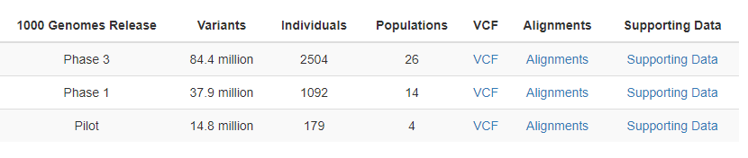
Genome Generation
Data Set
The dataset used comes from the institute of genomics of the University of Tartu (Estonia) and the IGSR (The International Genome Sample Resource)
https://genomics.ut.ee/en/biobank.ee/data-access
https://www.internationalgenome.org/data
Notes:
A binary format for genetic data designed for large whole genome studies that enable both marker and strand based analyses
Athos Antoniades; Loizos Loizou; Aristos Aristodimou; Constantinos S. Pattichis
https://ieeexplore.ieee.org/document/4696674

Slide 29
Genome Generation
RBM & GAN Decision
GAN and RBM are capturing a good potion of the population structure unlike the two simple generative models Bernoulli and Markov
Notes:
A Markov chain is a stochastic model describing a sequence of possible events in which the probability of each event depends only on the state attained in the previous event
Bernoulli process (named after Jacob Bernoulli) is a finite or infinite sequence of binary random variables, so it is a discrete-time stochastic process that takes only two values, canonically 0 and 1
Bernoulli : Each allele at a given position was randomly drawn given the derived allele frequency in the real population
PCA -> https://royalsocietypublishing.org/doi/10.1098/rsta.2015.0202

Slide 30
Genome Wide Reconstruction
Allele frequencies
Linkage disequilibrium
pair wise haplotype distances
Population structure

Slide 31
Genome Generation
Allele frequencies
Compare how frequent an allele is present in a gene pool
GAN doesn’t perform as well for low frequency alleles, due to a lack of representation of these alleles in the artificial genome whereas RBM seems to have wider distribution over all frequencies
Notes:
#of specific allele / total number of alleles
we removed alleles below 0.1 frequency from all datasets to eliminate
biases and analyzed LD decay and allele frequency spectrum

Slide 32
Genome Generation
Allele frequencies
Compare how frequent an allele is present in a gene pool
GAN doesn’t perform as well for low frequency alleles, due to a lack of representation of these alleles in the artificial genome whereas RBM seems to have wider distribution over all frequencies
Notes:
#of specific allele / total number of alleles
we removed alleles below 0.1 frequency from all datasets to eliminate
biases and analyzed LD decay and allele frequency spectrum

Slide 33
Genome Generation
Allele frequencies
Notes:
#of specific allele / total number of alleles
we removed alleles below 0.1 frequency from all datasets to eliminate
biases and analyzed LD decay and allele frequency spectrum

Slide 34
Genome Generation
linkage disequilibrium
Loci are said to be in linkage disequilibrium when the frequency of association of their different alleles is higher or lower than what would be expected if the loci were independent and associated randomly
Notes:
However, plotting LD as a function of the SNP distance showed that all models capture weaker correlation, with RBM outperforming the GAN model perhaps due to its slightly overfitting characteristic (Fig 2B). However, correlations between real and generated LD across all pairs were similar for GAN and RBM (for 1000 Genomes and Estonian respectively: 0.95 and 0.97 for GAN, 0.94 and 0.98 for RBM) and slightly lower than for test sets (0.99 and 1.0)
In genetics, a single-nucleotide polymorphism (SNP /snɪp/; plural /snɪps/) is a substitution of a single nucleotide at a specific position in the genome that is present in a sufficiently large fraction of the population (e.g. 1% or more).^{[1]}

Slide 35
Genome Generation
linkage disequilibrium
Notes:
However, plotting LD as a function of the SNP distance showed that all models capture weaker correlation, with RBM outperforming the GAN model perhaps due to its slightly overfitting characteristic (Fig 2B). However, correlations between real and generated LD across all pairs were similar for GAN and RBM (for 1000 Genomes and Estonian respectively: 0.95 and 0.97 for GAN, 0.94 and 0.98 for RBM) and slightly lower than for test sets (0.99 and 1.0)
In genetics, a single-nucleotide polymorphism (SNP /snɪp/; plural /snɪps/) is a substitution of a single nucleotide at a specific position in the genome that is present in a sufficiently large fraction of the population (e.g. 1% or more).^{[1]}

Slide 36
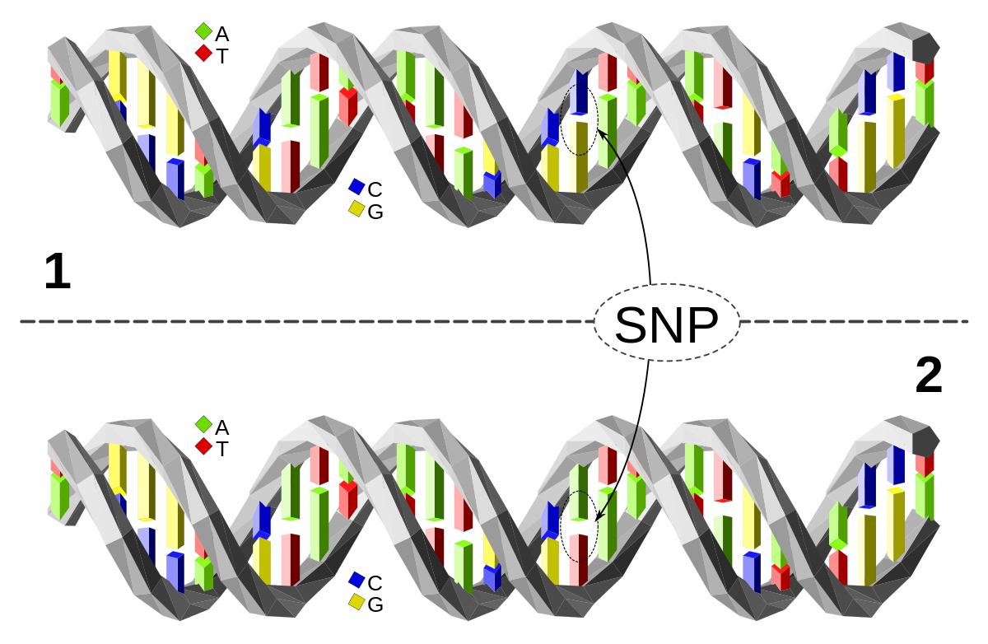
Genome Generation
pair wise haplotype distances
Wasserstein distance 117 and 227 for GAN, 38 and 26 for RBM which shows that RBM has once again better results than GAN
Notes:
The real, GAN and RBM distributions present similar multimodal patterns reflecting the underlying population structure (in particular the RBM distribution exhibits three modes corresponding to the average distances between European and Asian, European and African, or African and Asian populations
In mathematics, the Wasserstein distance or Kantorovich–Rubinstein metric is a distance function defined between probability distributions on a given metric space M
https://www.biorxiv.org/content/10.1101/108928v1.full

Slide 37
Genome Generation
Population structure
Population structure is the presence of a systematic difference in allele frequencies between subpopulations in a population.
Population structure are successfully preserved in AGs created using GAN and RBM models
AGs size doesn’t have any impact on population structure
Notes:
Population structure (or population stratification) is the presence of a systematic difference in allele frequencies between subpopulations in a population as a result of non-random mating between individual

Slide 38
Genome Generation
Results
No real genome was copied into the AGs (0 identical pair)
the distribution of the distance of real genomes to the closest AG neighbor shows that GAN model, although slightly underfitting, outperforms RBM model, for which an excess of small distances points towards overfitting
Multiple comparisons to existing genomes leads to believe that the genome has been properly generated
Upcoming work and advancement should lead into better comparisons between AG and real genome

Slide 39
Genome Generation
Improvement
- Shown in previous studies that imputation scores can be improved using
additional population specific reference panels
- Overfitting in RBM can be improved by stopping training early
Notes:
Our results showed that GAN AGs are possibly underfitting while, on the contrary, RBM AGs are overfitting, based on distribution of minimum distance to the closest neighbour (S8 Fig) and AATS scores (S13A Fig), although we showed how overfitting could be restrained by integrating AATS scores within our models as a criterion for early stopping in training (before the networks start overfitting) and by modifying the RBM sampling scheme
MaskGAN [16] which demonstrated good results in text gap filling might also be adapted for genetic imputation

Slide 40
Genome Generation
Improvement
Notes:
Our results showed that GAN AGs are possibly underfitting while, on the contrary, RBM AGs are overfitting, based on distribution of minimum distance to the closest neighbour (S8 Fig) and AATS scores (S13A Fig), although we showed how overfitting could be restrained by integrating AATS scores within our models as a criterion for early stopping in training (before the networks start overfitting) and by modifying the RBM sampling scheme
MaskGAN [16] which demonstrated good results in text gap filling might also be adapted for genetic imputation

Slide 41
Genome Generation
Next step
Ability to track back genome origin
Statistical calculation on privacy
Consistency improvement
Creation on new AG based on created AG
Notes:
Our results showed that GAN AGs are possibly underfitting while, on the contrary, RBM AGs are overfitting, based on distribution of minimum distance to the closest neighbour (S8 Fig) and AATS scores (S13A Fig), although we showed how overfitting could be restrained by integrating AATS scores within our models as a criterion for early stopping in training (before the networks start overfitting) and by modifying the RBM sampling scheme

Slide 42
Genome Wide Reconstruction
Pros:
- No parameters or demographics needed
- No duplication of real genome
- population diversification
- Ability to reuse trained and efficient models
Cons
- Complexity of proofs
- Privacy is not always guaranteed
- Generating single genome
- Difficulty to develop an optimal model

Slide 43
Genome Generation
Conclusion
First step of a new approach for artificial genomes generation
Needs a new way to evaluate
To be used a whole
Notes:
Our results showed that GAN AGs are possibly underfitting while, on the contrary, RBM AGs are overfitting, based on distribution of minimum distance to the closest neighbour (S8 Fig) and AATS scores (S13A Fig), although we showed how overfitting could be restrained by integrating AATS scores within our models as a criterion for early stopping in training (before the networks start overfitting) and by modifying the RBM sampling scheme

Slide 44
References
https://genomeprivacy.org/event/6th-international-workshop-on-%E2%80%8Bgenome-privacy-and-security-genopri19/
https://www.genome.gov/about-nhgri/Policies-Guidance/Privacy
https://scienews.com/images/2018/07/8c1d19aac7bc9d33a494c7e02a64386b.jpg
https://commonfund.nih.gov/sites/default/files/Artificial%20DNA%20molecule,%20the%20concept%20of%20artificial%20intelligence%20-%20587805514%20(750x420).jpg
https://deepai.org/machine-learning-glossary-and-terms/generative-adversarial-network
https://www.megaputer.com/wp-content/uploads/neural-network-diagram.png
https://www.researchgate.net/publication/340411893/figure/fig1/AS:877637589295105@1586256515794/a-Total-Analog-Memristive-Deep-Convolutional-Generative-Adversarial-Network-AM-DCGAN.ppm
https://medium.datadriveninvestor.com/an-intuitive-introduction-of-restricted-boltzmann-machine-rbm-14f4382a0dbb
https://www.internationalgenome.org/data
https://machinelearningmastery.com/rectified-linear-activation-function-for-deep-learning-neural-networks/

Slide 45
References
https://www.internationalgenome.org/data
https://machinelearningmastery.com/rectified-linear-activation-function-for-deep-learning-neural-networks/
https://genomics.ut.ee/en/biobank.ee/data-access

Slide 46

Closing Slide

